Slide 1
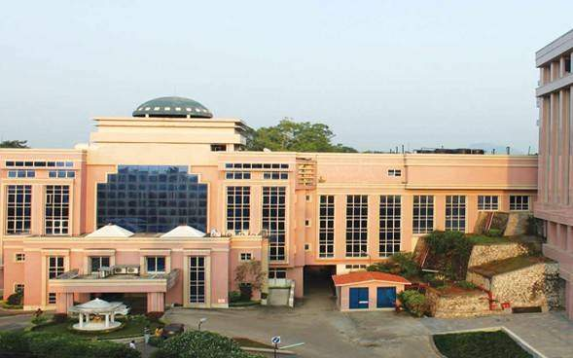

Efficacy of RevitalVision technology in improving vision in Adult Amblyopia
FP-674
Dr. Damaris Magdalene
M13311, Assam
Pediatric Services
Sri Sankaradeva Nethralaya, Guwahati, Assam , India.
No Financial interest

Slide 2
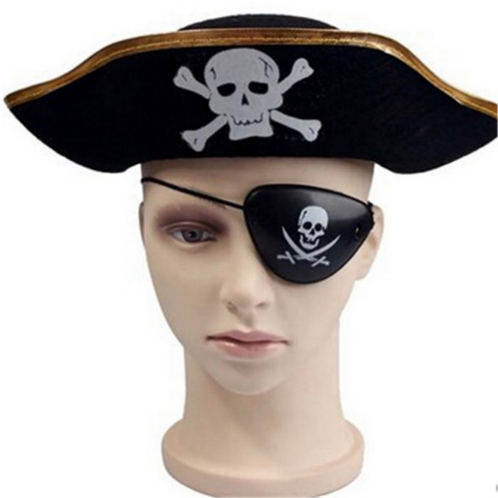
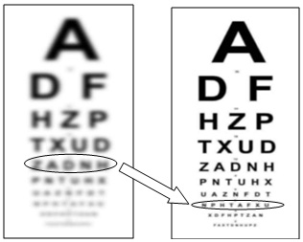
AIM
To evaluate the efficacy and safety of RevitalVision in improving visual acuity in patching resistant amblyopic eyes of patients older than 9.

Slide 3
Study Methods
The study and protocol conformed to the tenets of the Declaration of Helsinki. Informed consent was obtained from all the patients.
All patients underwent at least 6 months of patching therapy with no visual improvement prior to starting the RevitalVision therapy.

Slide 4
Study Criteria
Exclusion criteria consisted of any other ocular condition or cause for reduced visual acuity other than anisometropia, ametropia, amblyopia due to strabismus and visual deprivation and nystagmus.

Slide 5
Examinations
Baseline examination included subjective and objective refractions, cycloplegic subjective and objective refractions, uncorrected and best-corrected distance visual acuities (BCVA) were tested using an ETDRS LogMAR visual acuity chart.
The baseline contrast sensitivity was also documented. The patients then underwent slit-lamp biomicroscopy and fundus evaluation by binocular indirect ophthalmoscopy.
All the cases in the study then underwent an orientation guided by the trainer.

Slide 6
Compliance analysis
54 patients age 9 – 60 started the therapy program
  9 patients who started the program failed to comply (16.7%)
  45 patients completed the therapy with good compliance (83.3%)
Compliance criteria:
We included patients who complied with minimum training instructions:
  At least 25 training sessions out of 40 required
  At least 10 sessions per month out of 12 -15 required

Slide 7
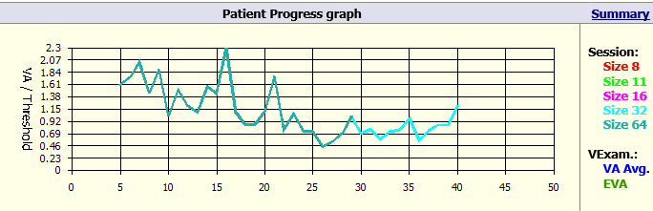
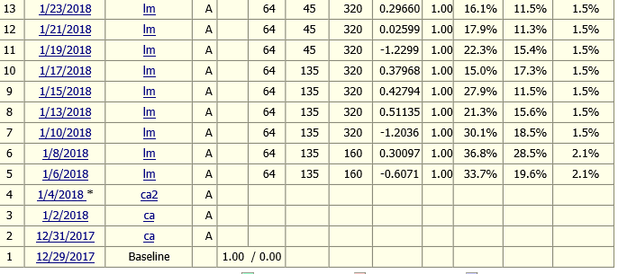
Example of Complying Patient
Completed 40 sessions in sequence, every 2 days

Slide 8
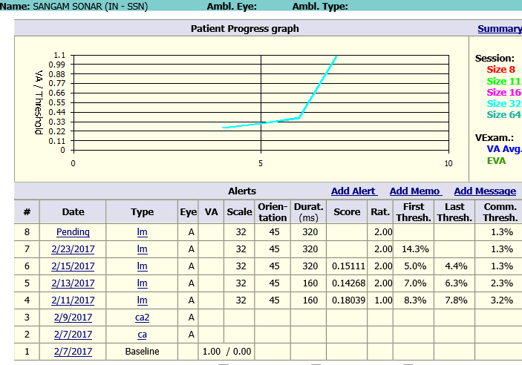
Non Complying Patient
Stopped after 6 sessions

Slide 9
Study population
This prospective study comprised of 45 patients between 8 and 60 years of age, of which 39 had amblyopia due to refractive error ,3 due to visual deprivation , two cases had nystagmus and one case had strabismus.
All had undergone patching therapy prior to RevitalVision therapy.
The main outcome measures were distance best corrected visual acuity (BCVA).

Slide 10
Distribution of cases on the basis of etiology
Causes |  | Frequency | Percentage
Refractive | Hyperopia | 13 | 28.89%
 | Mixed Astigmatism | 10 | 22.22%
 | Ametropia (Hyperopia) | 6 | 13.33%
 | Compound Myopic Astigmatism | 5 | 11.11%
 | Myopia | 3 | 6.67%
 | Ametropia (Myopia) | 1 | 2.22%
 | Compound Hyperopic Astigmatism | 1 | 2.22%
Nystagmus |  | 2 | 4.44%
Strabismus |  | 1 | 2.22%
Visual deprivation |  | 3 | 6.67%
 | Total | 45 | 100.0

Slide 12
VA Improvement
Age | VA Lines improvement | # Patients
8 to 12 | 1.4 | 16
13 to 18 | 2.0 | 17
20 to 29 | 2.7 | 8
30 to 60 | 2.9 | 4
Average | 2.0 | 45

Slide 13
Improvement vs age group
# 16

Slide 14
Conclusion
Our study is the first prospective study in India to report the efficacy and safety of this novel non-invasive perceptual learning computerized program called RevitalVision.
Our study confirms current published data of enhanced BCVA of 2 + lines in adult amblyopic individuals not responding to the traditional patching therapy.

Slide 15
Limitations
Limitations of this study include the absence of a comparative control group and a small sample size
Preliminary evidence suggests RevitalVision PL treatment is safe and improves BCVA in adult amblyopic patients who do not respond to the traditional patching therapy.
Thank you!

